Slide 1
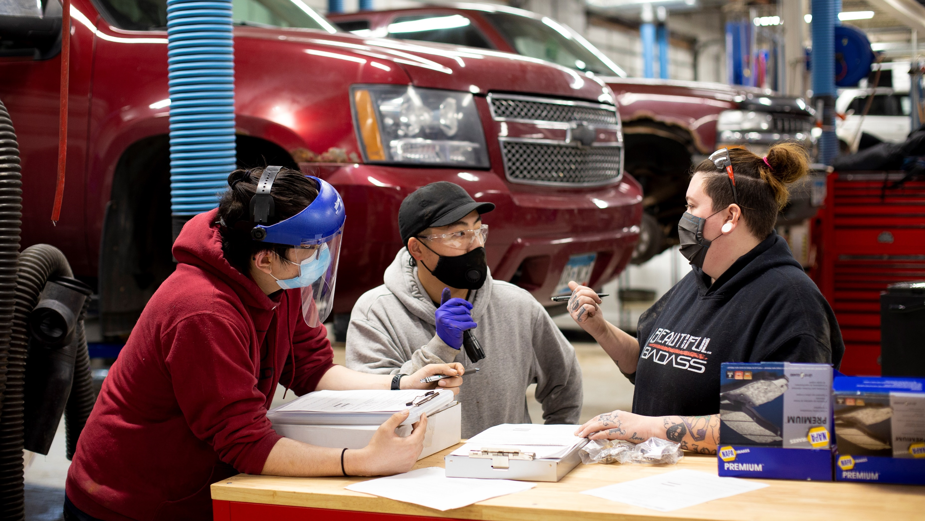
Not Synthetic Oil and Water:
The Relationship between Automotive Faculty and Administration at a Technical College
2023 ACTE Region V Leadership Conference

Slide 2
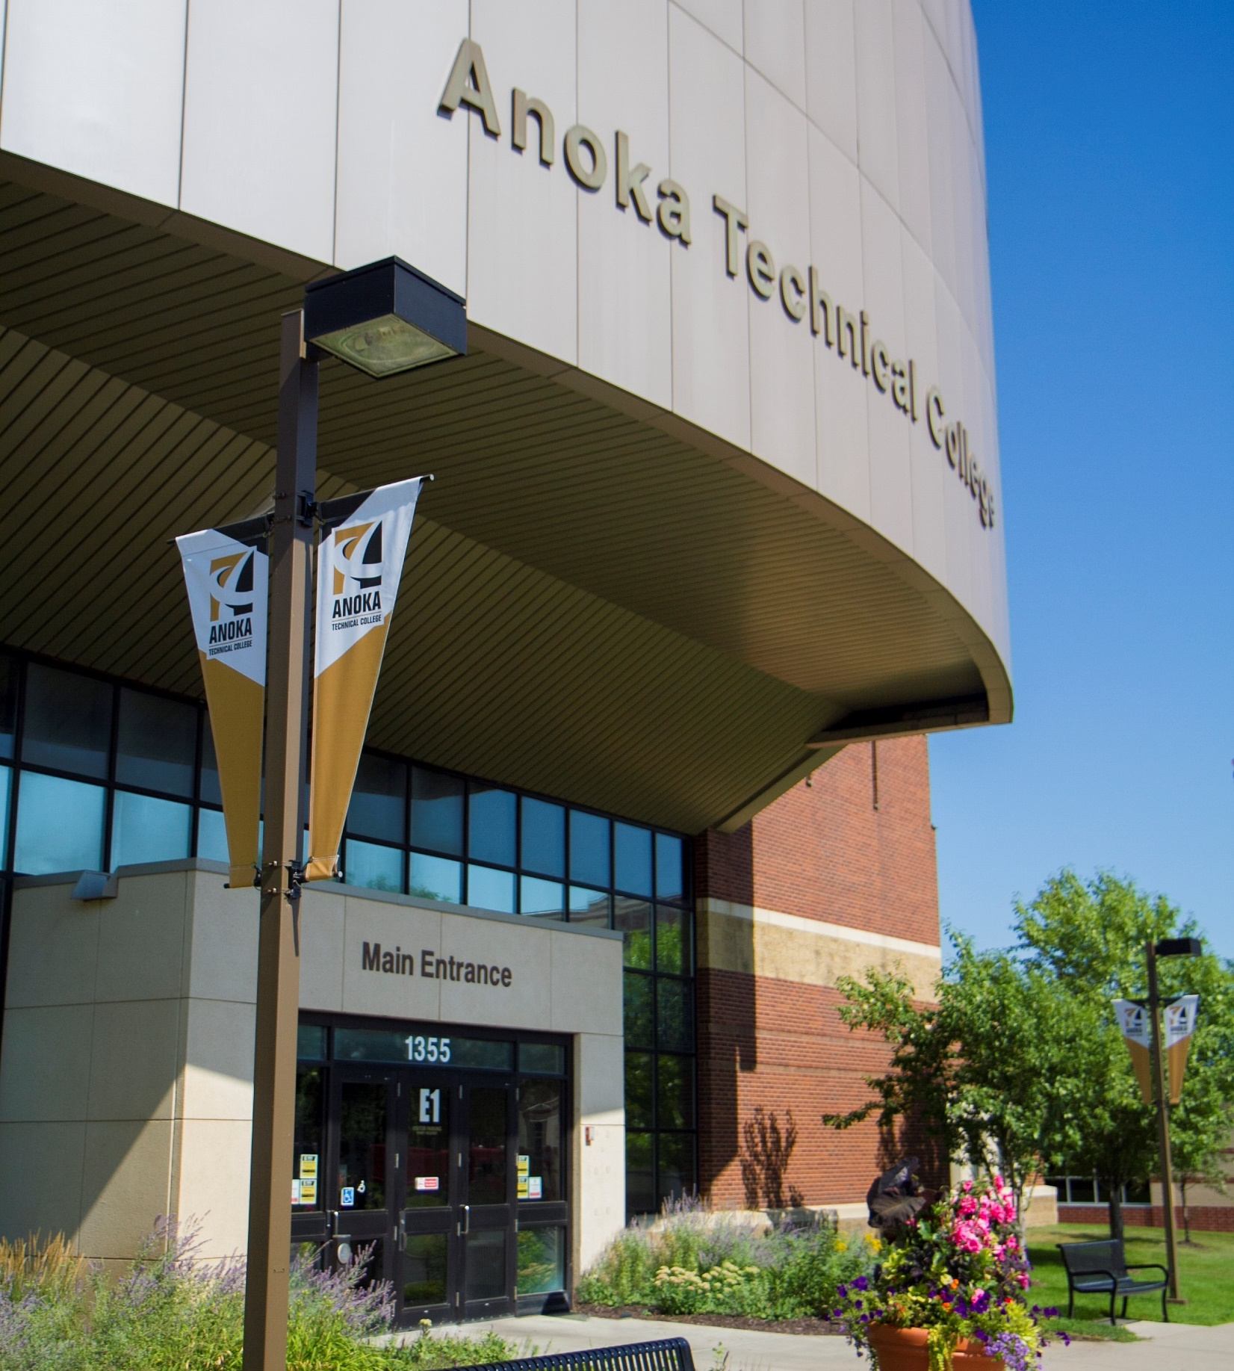
Not Synthetic Oil and Water
Introductions
Dimitria Harding
-Servant leader
-Previous CTE Dean
Dave Holmquist
-Customer relations
-Industry skillset
“The Title”
Summer 2022 meet-and-greet

Slide 3
Agenda
History of the College
Presidential Leadership
Shared Governance
Faculty/VP Commitment
Automotive Technology Program Challenges
Questions / Conversation

Slide 4
How would you describe the relationship between faculty and administration at your institution?

Slide 5
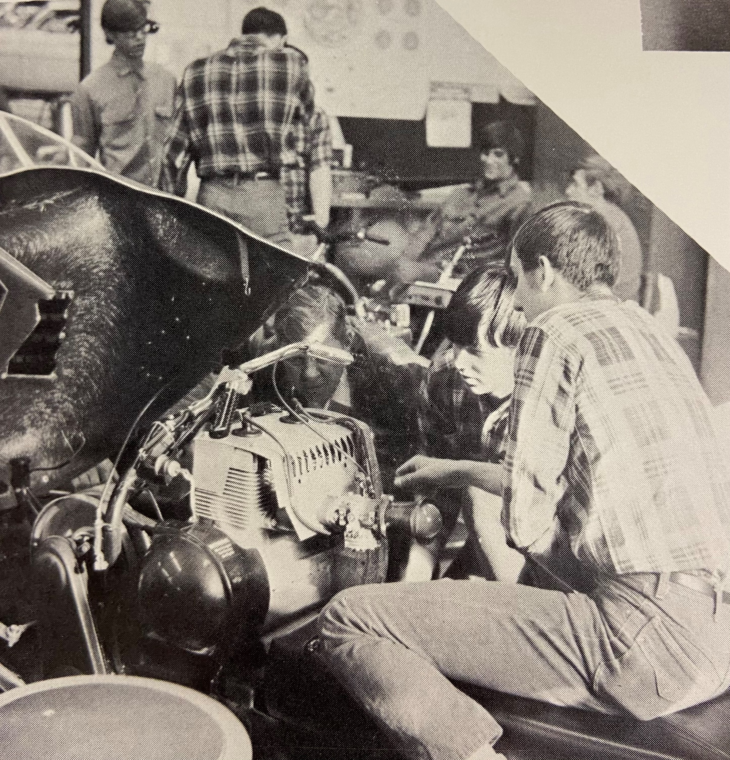
History of the College
Anoka Technical College
-Anoka, MN
Faculty
Administration
Institutional Culture
-Complex relationship
-Dysfunctional family

Slide 6
President’s Leadership
President: 10 years
Communication
Transparency

Slide 7
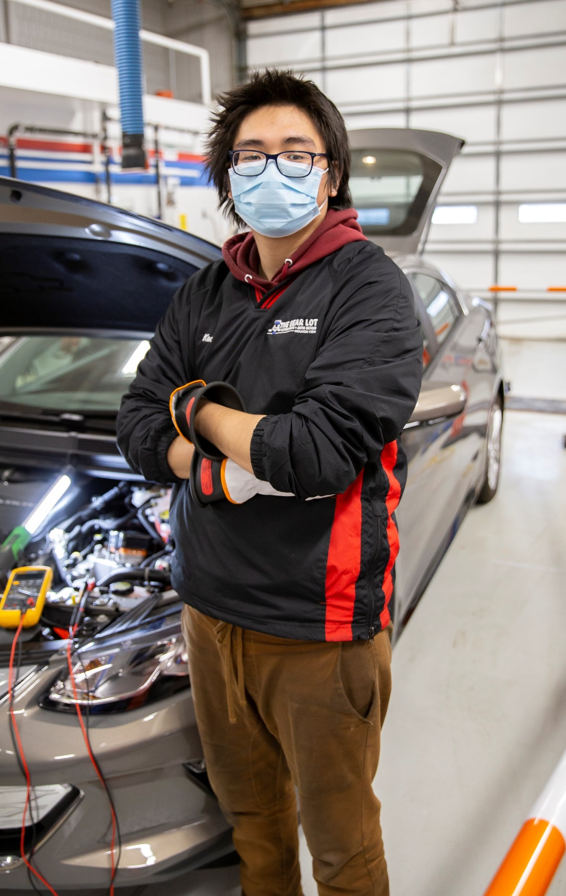
Shared Governance
Shared governance strengthens institutions by championing meaningful engagement and inclusive, transparent decision-making (AGB, 2017)
Ideally, shared governance is characteristically collegial. (BoardEffect, 2023).
Tension seems to be inevitable in shared governance, as constituencies with “different needs and priorities” come together to make decisions with broad implications (Weilundemo & Mathews 2015).
Notes:
References
https://agb.org/knowledge-center/board-fundamentals/shared-governance/
https://www.boardeffect.com/blog/shared-governance-model-higher-education-boards/

Slide 8
What is your definition of “communication?”

Slide 9
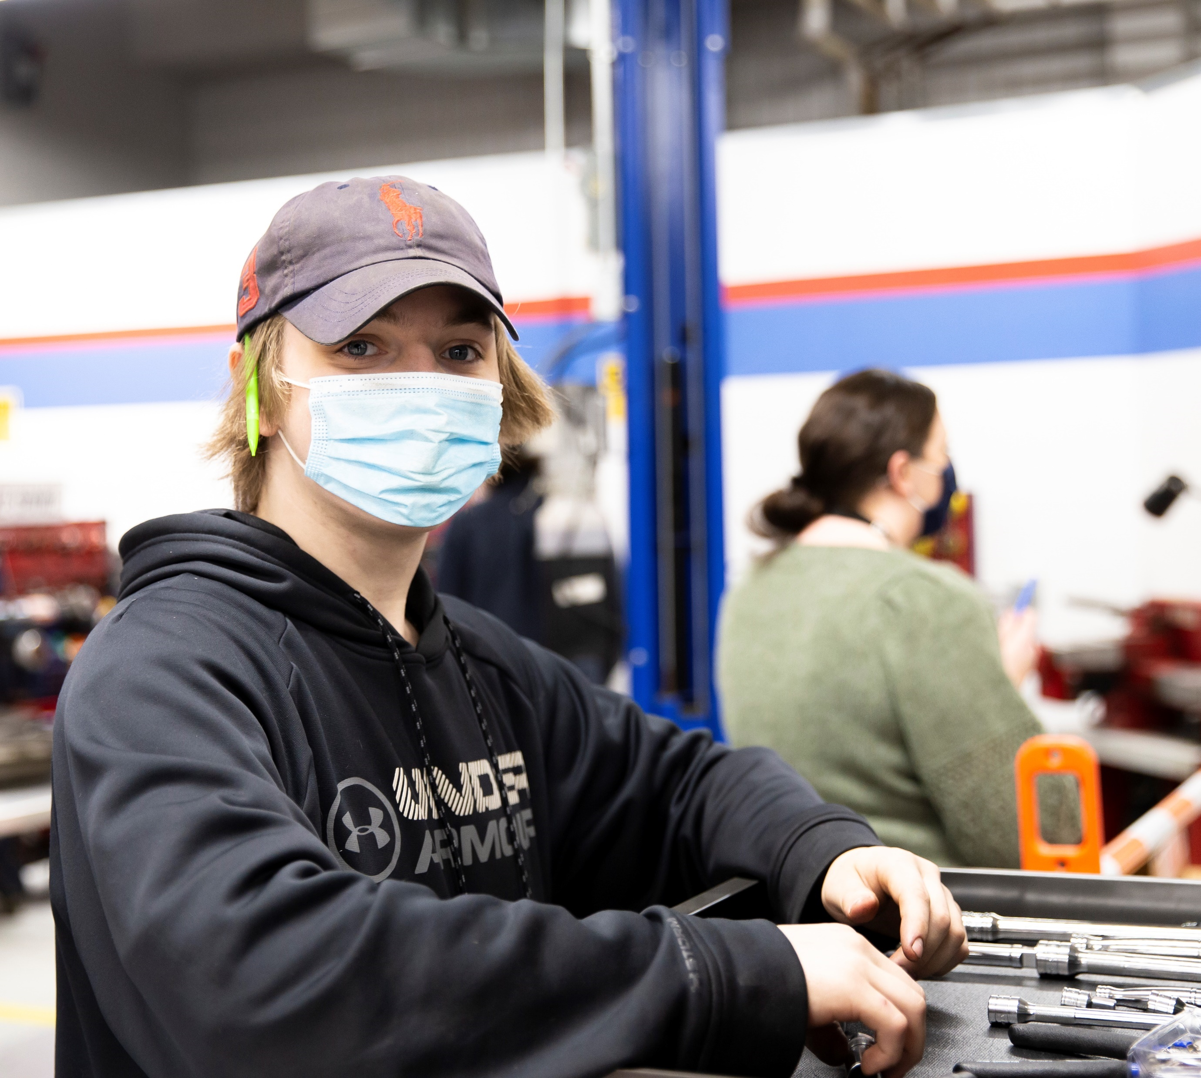
Faculty/VP Commitment
Communication
Honesty
Shared sense of purpose
What’s best for our students?
Understanding the issue at hand
Adaptability: new leadership
Accountability

Slide 10
What are some challenges you’ve faced when creating new programs at your institutions?
Notes:
Audience question

Slide 11
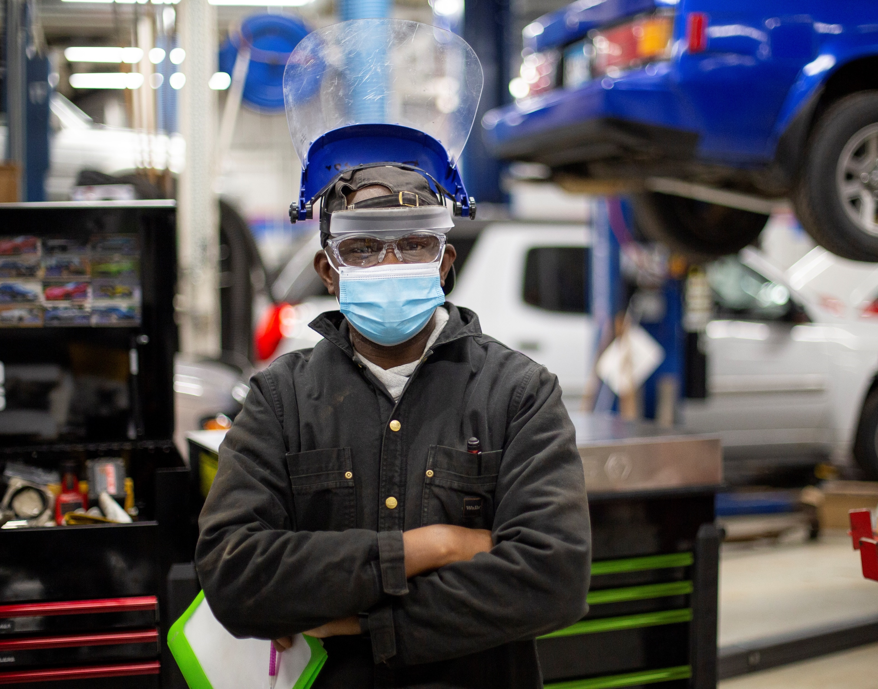
Automotive Program Challenges
New Automotive Electronic Diagnostic Specialist
Open Auto Faculty Positions
-New Faculty onboarding
Budgeting
Student Recruitment/Retention
I was called “a jerk”

Slide 12
Summary
How do you navigate leadership challenges during times of change?
Leadership-define
Communication
Commitment
Teamwork

Slide 13
Thank you

