Slide 1
LEADERSHIP DURING AN EXTENDED CRISIS: The lived experience of one administration during the COVID-19 Pandemic
Presented to: ACTE Region V
By: Jennifer A. McConville. Ed. D Nebraska College of Technical Agriculture

Slide 2
Extended crisis Pandemic Stress
Bad Mood
Brain Fog
Fatigue
Loneliness

Slide 3
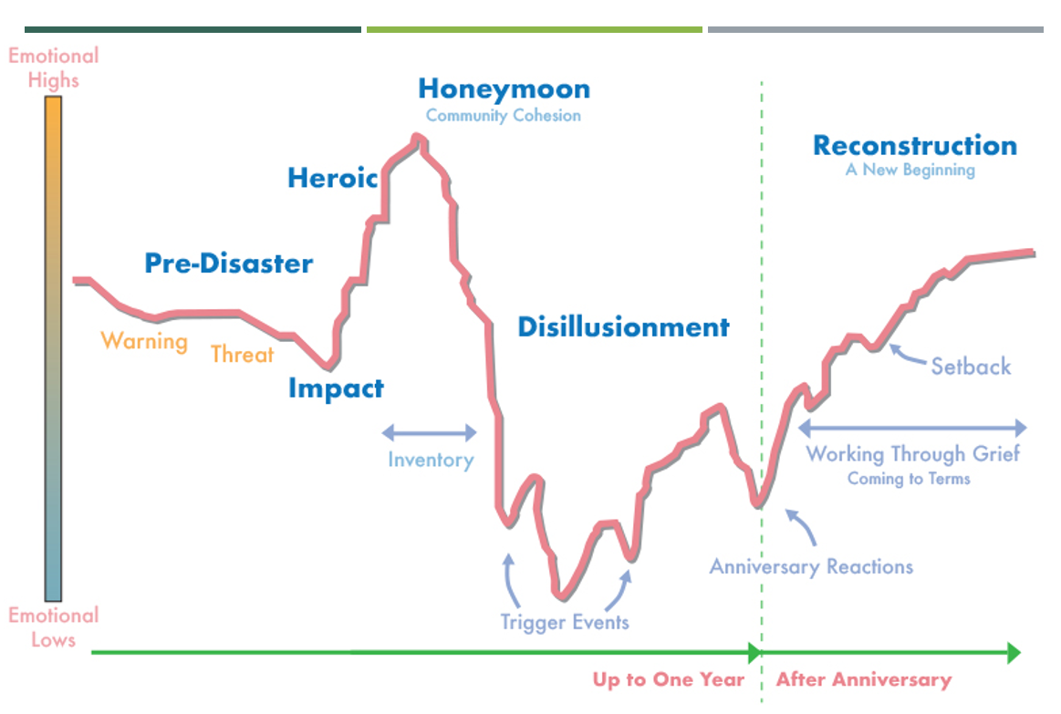
How we react to crisis
Kira Mauseth, Ph.D.
Astrum Health, LLC

Slide 4
What Happened during covid

Slide 5
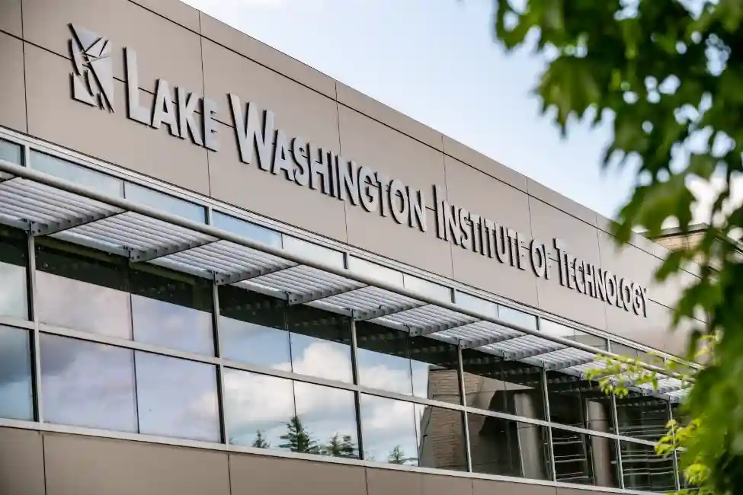
The participants and the process
Lake Washington Technical College=Campus Zero

Slide 6
Navigating the crisis
Proactive Leadership
Teamwork
Pivot
Goal Focused
Communication

Slide 7
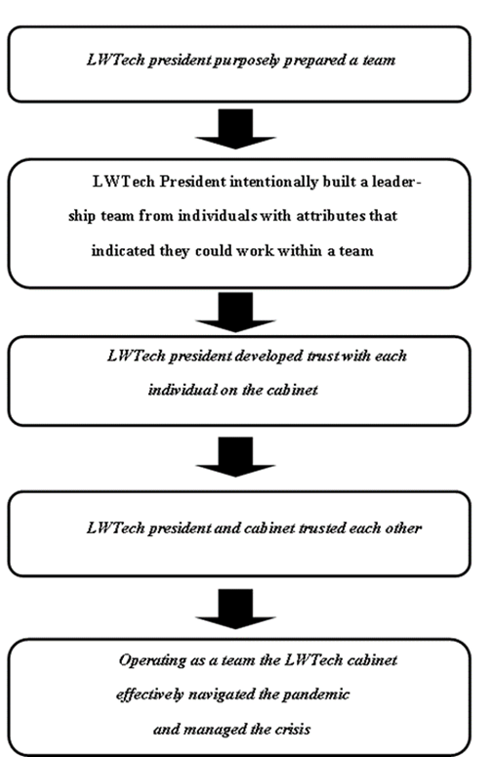
Proactive Leadership

Slide 8
Conclusion and recommendations for practice
Build our teams
Build trust within our teams
Continue to build those relationships
Be prepared to make changes
“Ever since then, she has called us The Dream Team, and so now we’re the Dream Team, and because we really did pull it off- really well!”

