Slide 1
Teaching as a Profession Grow Your Own
Recruitment & Retention
Date: April 13, 2023
Time: 9:45-10:45 am
Location: Mozart II
​

Slide 2
Jane Luethge
OPS TLC for Post-Secondary Partnerships; Teaching as a Profession, Freshman Academy (2021-present)
OPS Curriculum Specialist-Burke High School (2014-2021)
OPS English Teacher Central High School (2004-2014)
Contact Information
@JMLuethge on Twitter
Jane.Luethge@ops.org

Slide 3
Who is in the room?
Middle School Teacher
High School Teacher
Department Head/Curriculum Specialist
School Administrator
District Administrator
CTSO Advisor
Parent/Guardian of a PreK-16 student
ACTE Staff

Slide 4
Learning Goal
Participants will learn about the Grow Your Own model in The Omaha Public Schools and share with colleagues about what they do in their school/districts.

Slide 5
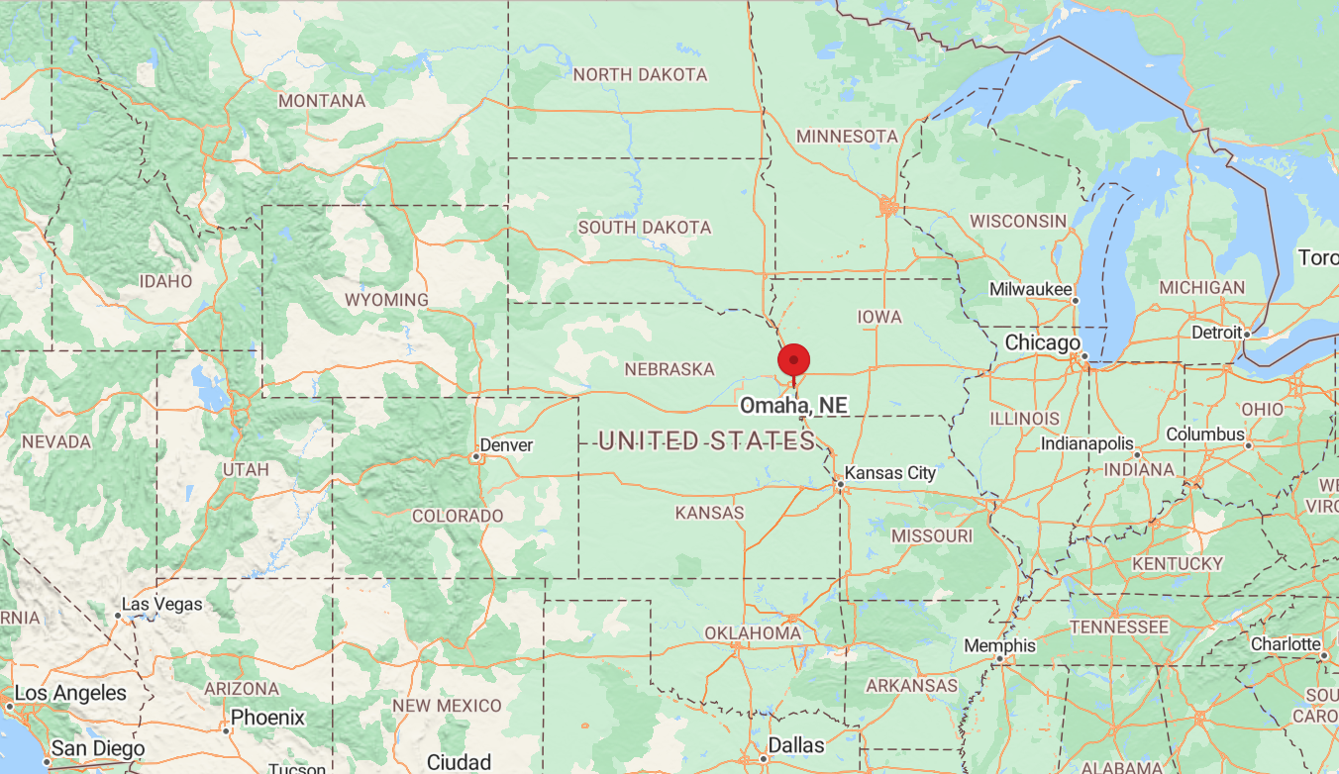
The Omaha Public Schools
Schools (22-23)
High Schools (9)
Middle Schools (13)
Elementary Schools (65)
Students (53,000)
Teachers/Staff (9,000+)
College and Career Academy/Pathways (CCAP)
Teaching as a Profession Pathway (8 high schools)
Education Academy
(1 high school)

Slide 6
Grow Your Own
Coursework
Educators Rising (CTSO)
Summer Interns

Slide 7
Coursework
Aligned to NDE 23-24 Standards
Co-curricular (Educators Rising) connections in lessons

Slide 8
Teaching as a profession pathway
Teaching as a Profession | OPS Course Name | Teacher Credentials
Year 1, Semester 1 | Lifespan Development | FCS
Year 1, Semester 2 | Principles of Education* | Education and Training Other Endorsement
Year 2 | Best Practices in Educ | Education and Training Other Endorsement
Year 3 | Field Exp in Educ Training | Education and Training Other Endorsement
*Course is aligned to college/university partner and offered for dual credit

Slide 9
Education Academy
Counseling and Mental Health | Course Name | Teacher Credentials
Year 1-Semester 1 | Lifespan Development | FCS
Year 1-Semester 2 | Human Relations* | Agriculture, Basic Business, Business, Marketing, Info Tech, Family/Consumer Science, Middle Gr/AG Education, Middle GR/Business Ed, Middle GR/Industrial Tech, School Counselor, Skilled and Technical Sciences
Year 2-Semester 1 | Careers in Mental Health | FCS
Year 2-Semester 2 | Families in Crisis | FCS
Year 3 | Family and Community Advocacy | TBA
Years 2-3 optional electives | AP Psychology*, Sociology* | Social Sciences
*Course is aligned to college/university partner and offered for dual credit

Slide 10
Educators Rising
CTSO: Career and Technical Student Organization
Co-curricular

Slide 11
CTSO-Educators Rising
Educators Rising chapter (9 high schools)
Attend Expo PD and compete @State Leadership Conference
8/9 high schools attended
7/9 had competitors
140/300 students from Omaha Public Schools
47 qualified for Ed Rising Nationals
Support school-wide education initiatives
Be involved at Educators Rising State and/or
National levels

Slide 12
Summer Interns
Support elementary school students/teachers
Provide real-world experience in classrooms
Paid Internship ($12/hour)

Slide 13
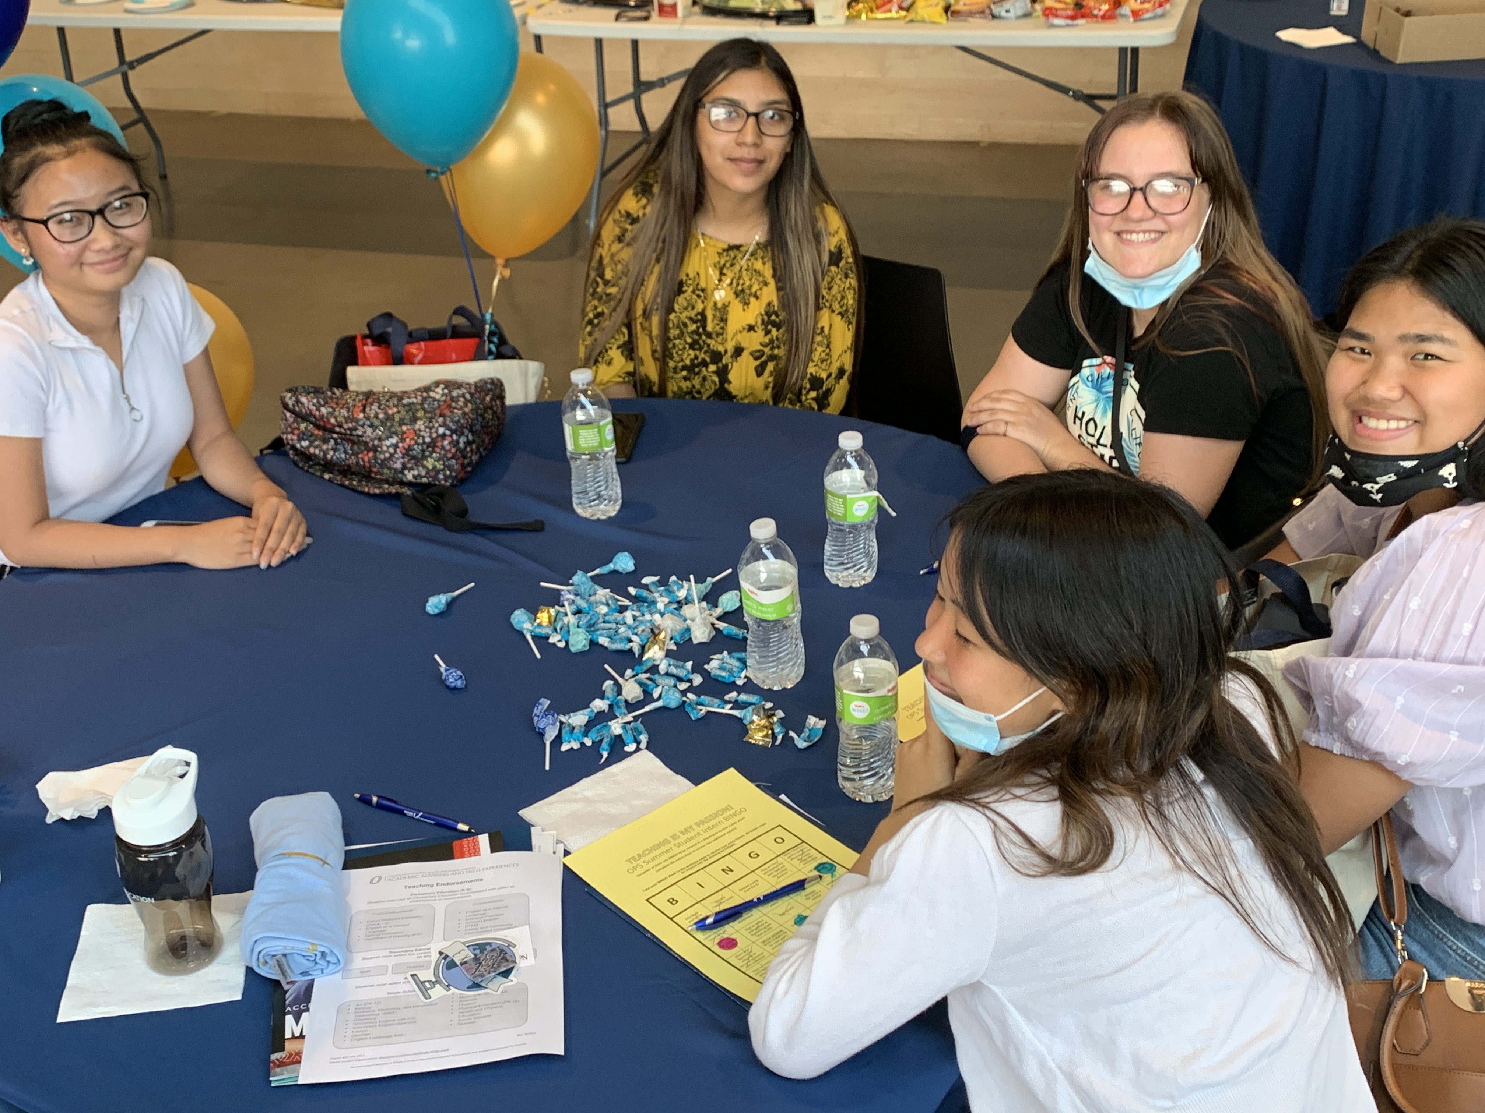
Summer Interns
Hire high school interns (16+)
Training
HR Onboarding
OPS Early Childhood Literacy Support
Numbers
21-22
200 goal/ 168
64 schools
22-23
500 goal/ 282
17 super site schools

Slide 14
Your Turn
What do you already do in your school/district to provide opportunities for students to learn about Teaching as a Profession?

Slide 15
Learning Goal
Participants will learn about the Grow Your Own model in The Omaha Public Schools and share with colleagues about what they do in their school/districts.

Slide 16
Thank You!
Contact Information
@JMLuethge on Twitter
Jane.Luethge@ops.org

